Slide 1
University Physics I, part III.
Introduction to thermodynamics and Heat transfers
Teacher: Dr. Paul Briard
Email: paulbriard@outlook.com
Wechat: Paulbg123

Slide 2
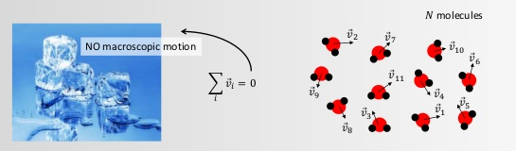
Lesson 1: Describe the macroscopic from the microscopic
https://image.slidesharecdn.com/heat-141118164937-conversion-gate01/95/heat-7-638.jpg?cb=1416329429

Slide 3
Contents
Basics of thermodynamics
The ideal gas and the ideal gas law
Microscopic description of the ideal gas

Slide 4
1. Basics of thermodynamics

Slide 5
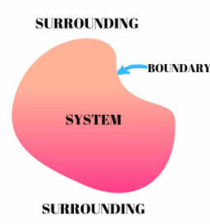
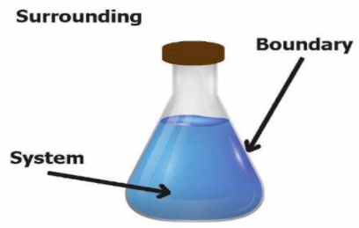
Thermodynamic systems
A thermodynamic system consisting of a large number of molecules (mainly gas molecules, for our study)
https://lawofthermodynamicsinfo.com/what-is-thermodynamic-system/

Slide 6
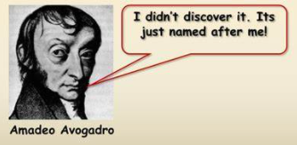

The Avogadro’s number
$$N_{A}=\text{6.022 }×{10}^{23}$$
The Avogadro’s number:
The amount of molecules is described by the amount of mole (unit: mole, symbol: mol)
1mol of gas has 6.022 x 10²³ molecules of gas
http://www.sliderbase.com/spitem-192-1.html

Slide 7
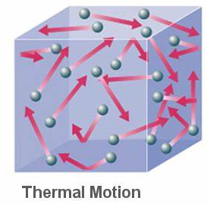
What is studied in this lesson ?
The thermal phenomena (i.e. the thermal motion of molecule of gas)
For a large number of molecules, the thermal motion follows statistic laws
http://www.universe-review.ca/R15-38-Qinterp.htm
“All thermal phenomena reduce ultimately to the mechanical movement of the atoms and molecules in a body. ”
https://www.sciencedirect.com/topics/physics-and-astronomy/thermal-phenomena

Slide 8
The purpose of the study
Describe the microscopic and macroscopic behaviour of thermodynamic systems
In our study, “microscopic” and “macroscopic” are a bit different than in common definitions (microscopic: can’t be seen with naked eye, macroscopic: can be seen with naked eye).
Microscopic approach: the statistic laws which describe the behaviour of single molecules
Macroscopic approach: the average behaviour involved with the interaction of a large number of molecules

Slide 9
Microscopic and macroscopic descriptions
Macroscopic description:
Macroscopic state of the system state is described by physical quantities such as:
The pressure (symbol P)
The temperature (symbol T)
The volume (symbol V)
They can be measured by different kinds of instrument.

Slide 10
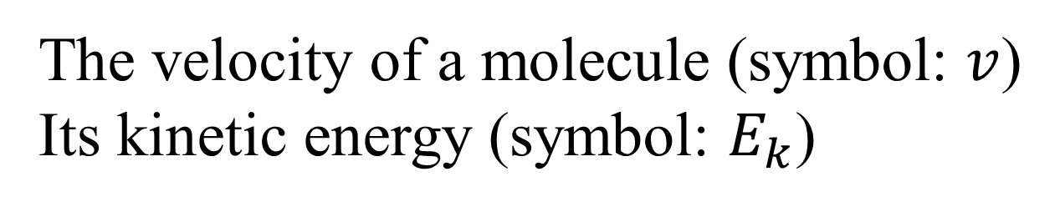
Microscopic and macroscopic descriptions
Microscopic description:
Microscopic description of the behaviour a molecule, such as:
The velocity of a molecule (symbol: $v$)
Its kinetic energy (symbol: $E_{k}$)
The microscopic behaviour permits to understand the macroscopic behaviour of molecules in a gas !

Slide 11
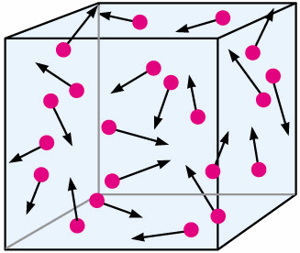
State parameters of a gas
The pressure (P)
Macroscopic description:
The pressure describes the force exerted by the gas per unit area on the walls
Microscopic description:
It is the amount of collisions between the gas molecules and the walls
https://www.studyblue.com/notes/note/n/chemistry-101-chapter-10-gases/deck/4802352

Slide 12
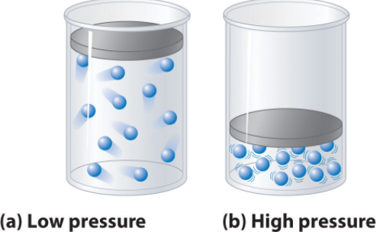


State parameters of a gas
The pressure (P)
https://chem.libretexts.org/Courses/Howard_University/General_Chemistry%3A_An_Atoms_First_Approach/Unit_5%3A_States_of_Matter/Chapter_11%3A_Fluids/Chapter_11.01%3A_Real_Gases
SI unit of the pressure: The Pascal (symbol Pa)
$$1 Pa=1 N.m^{−2}$$
Important to remember
Other units of the pressure (not SI unit): the atmosphere (symbol: atm), inches of mercury (symbol: Hg), centimeters of mercury (symbol: cmHg), …
(for your information, don’t need to remember)
$$1 atm=76 cmHg=1.013×{10}^{5} Pa$$

Slide 13
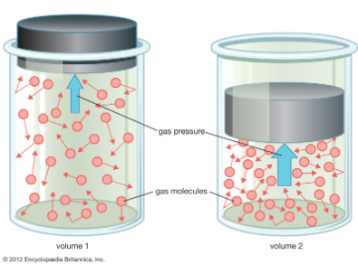
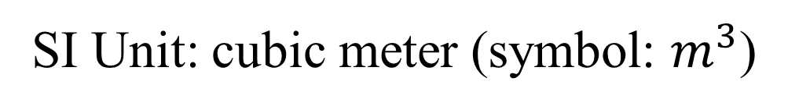
State parameters of a gas
The volume (V)
The space occupied by the gas
SI Unit: cubic meter (symbol: $m^{3}$)
Unlike solids and liquids, at equilibrium, a gas occupy all the volume available

Slide 14

State parameters of a gas
The temperature (T)
Describes the degree of hotness of a body
Describe the thermal activity (thermal motion) of the molecules
SI unit of the temperature: The Kelvin (symbol: K)
$$T\left(K\right)=t(°C)+273.15$$
Important to remember
Temperature in Celsius scale

Slide 15
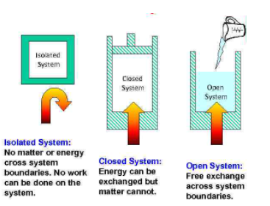
Different kinds of thermodynamic systems
http://present5.com/chemical-thermodynamics-lesson-plan-1-types-of/
An isolated system is also defined as a state where macroscopic parameters do not change over time (because there is no exchange of matter and energy)

Slide 16
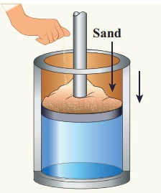
Quasi-static process
“an infinitely slow process in which the system changes its variables (P,V,T) so slowly such that it remains in thermal, mechanical and chemical equilibrium with its surroundings throughout. “
http://www.brainkart.com/article/Quasi-static-process_36242/#:~:text=A%20quasi-static%20process%20is%20an%20infinitely%20slow%20process,system%20is%20always%20almost%20close%20to%20equilibrium%20state.
By this infinite slow variation, the system is always almost close to equilibrium state.
http://www.brainkart.com/media/extra3/FJW0KA8.jpg#

Slide 17
Quasi-static process
p
O
V
Evolution of the pressure of a gas in respect to its volume, in a quasi-static process.
All intermediary states are almost at equilibrium.
http://www.brainkart.com/media/extra3/FJW0KA8.jpg#

Slide 18
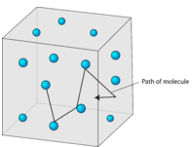
Molecular motion
The intermolecular forces explain the different behaviour of solids, liquids, and gas.
In a gas, a molecule move in straight line until it collides with another molecule or a wall, excepted at the collision, the intermolecular distances are much greater than in solids and liquids.
https://files.mtstatic.com/site_4334/78465/0?Expires=1610553335&Signature=Jcpy17UrqtoOQuDpcs9HAHCs5cgLIkNuazVQxOnwwjxWZXTjS15u1XiPHvngzRogGBrRFZQx9f~Gz-v9inrUnezb5lpKMHjeKQrMzlUXZmG7GZU~bwNXjK9KOEr5BHucpnGU-ug2oqv~T5PqDalMmz0GVGM9znd06CeYbd469zA_&Key-Pair-Id=APKAJ5Y6AV4GI7A555NA

Slide 19
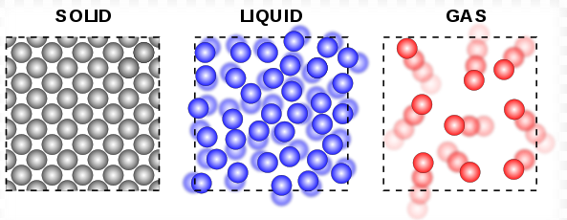
Molecular motion
Even in liquids and solids, molecules have motion, which is different than motion in gas:
In solid, the molecules have vibration motion around a fixed point,
In liquids, the intermolecular distances are greater than in solids, and the molecules have more freedom of motion
https://en.wikiversity.org/wiki/Fluid_Mechanics_for_Mechanical_Engineers/Introduction

Slide 20
2. The ideal gas and the ideal gas law

Slide 21
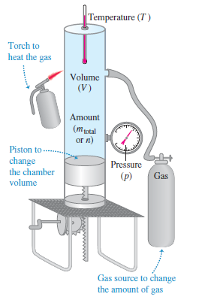
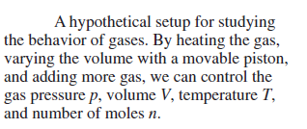

The ideal gas and the ideal gas law
$m_{total}:$ the total mass of gas in the volume V
We consider a gas in a piston where the temperature T, the volume V, or the pressure p can change

Slide 22
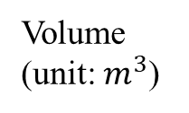
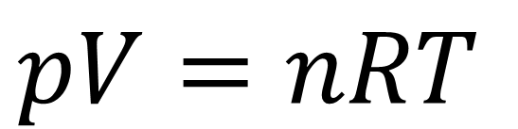
The ideal gas and the ideal gas law
$$pV=nRT$$
Ideal gas law
Important to remember
Pressure (unit: Pa)
Volume
(unit: $m^{3}$)
Number of moles of the gas (describes quantity of molecules), unit: mol
Temperature (unit: K)
An ideal gas is a gas which hold the ideal gas law for all pressure and temperature.
A real gas is never perfectly an ideal gas (which is an idealized model). It has the behaviour of an ideal gas for a certain range of pressure and temperature.

Slide 23

The ideal gas and the ideal gas law
$$pV=nRT$$
Ideal gas law
Important to remember
Pressure (unit: Pa)
Volume
(unit: $m^{3}$)
Number of moles of the gas (describes quantity of molecules), unit: mol
Temperature (unit: K)
R is the ideal-gas constant:
$$R=8.31 J.{mol}^{−1}K^{−1}$$

Slide 24
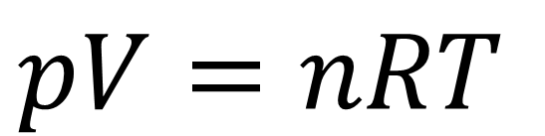

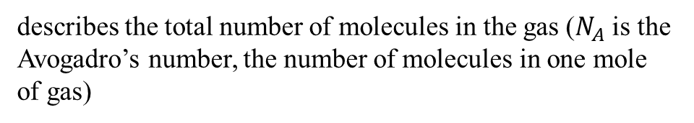

Alternative form of the ideal gas law
$$pV=nRT$$
$$pV=Nk_{B}T$$
Alternative form of the ideal gas law
(important to remember)
where
$$N=N_{A}n$$
describes the total number of molecules in the gas ($N_{A}$ is the Avogadro’s number, the number of molecules in one mole of gas)
$k_{B}=\frac{R}{N_{A}}$is the Boltzmann constant (another symbol used for it is “k”)

Slide 25
3. Microscopic description of the ideal gas

Slide 26
The kinetic molecular model of the ideal gas
Some assumptions are necessary to describe the ideal gas:
The number of molecules is large and the average separation between the molecules is much larger than the molecule size. The molecules are considered point-like.
Any molecule can move at any direction and speed.
Molecules interact only during collision (outside collision, the intermolecular force is neglected)
Collisions with the walls are elastic
All molecules are the same.

Slide 27
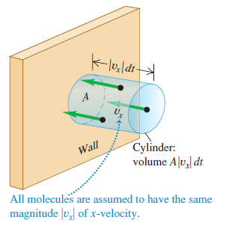
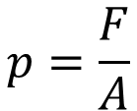
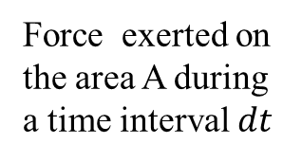
The kinetic molecular model of the ideal gas
The x-component of the velocity of a molecule (component perpendicular with the wall)
(to simplify the description we consider it’s the same for all the molecules, which is not strictly right)
We want to describe the pressure of the gas, which is the force exerted by the molecules of the gas on the wall per unit area
$$p=\frac{F}{A}$$
Force exerted on the area A during a time interval $dt$
We need to describe the count of collisions on the wall during the time $dt$ and the change of momentum associated with the collisions (which are elastic )

Slide 28
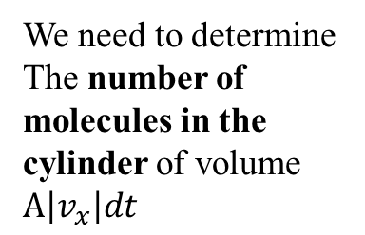
The kinetic molecular model of the ideal gas
We need to determine The number of molecules in the cylinder of volume $A\left|v_{x}\right|dt$
We want to describe the pressure of the gas, which is the force exerted by the molecules of the gas on the wall per unit area
$$p=\frac{F}{A}$$
Force exerted on the area A during a time interval $dt$
We need to describe the count of collisions on the wall during the time $dt$ and the change of momentum associated with the collisions (which are elastic )

Slide 29


The kinetic molecular model of the ideal gas
We need to determine The number of molecules in the cylinder of volume $A\left|v_{x}\right|dt$
We assume the number of molecules per unit volume is uniform and equals $N/V$
$$\frac{N}{V}A\left|v_{x}\right|dt$$
The number of molecules in the cylinder is:
Half of these molecules move toward the wall (the other molecules moves away)
$$\frac{N}{2V}A\left|v_{x}\right|dt$$
The number of collisions which occurs during $dt$ is:

Slide 30
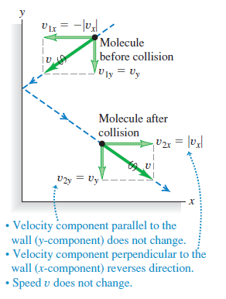
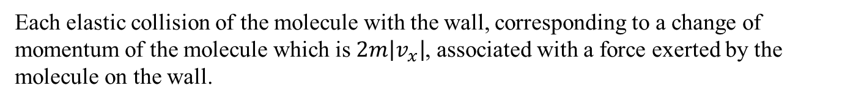
The kinetic molecular model of the ideal gas
Each elastic collision of the molecule with the wall, corresponding to a change of momentum of the molecule which is $2m\left|v_{x}\right|$, associated with a force exerted by the molecule on the wall.

Slide 31








The kinetic molecular model of the ideal gas
After few mathematics, from the force exerted by one gas molecule during collision (which correspond to the change rate of momentum) with the wall, the pressure is described as:
$$p=\frac{mN\overline{v_{x}^{2}}}{V}$$
where
$\overline{v_{x}^{2}}$ is the average value of ${v_{x}}^{2}$
We can describe the pressure in respect to the average velocity of the particles $\overline{v}$
$$v^{2}=v_{x}^{2}+v_{y}^{2}+v_{z}^{2}$$
$$\overline{v^{2}}=\overline{v_{x}^{2}}+\overline{v_{y}^{2}}+\overline{v_{z}^{2}}$$
Considering the x-,y-,and z-directions have no difference (gravity is neglected)
$$\overline{v_{x}^{2}}=\overline{v_{y}^{2}}=\overline{v_{z}^{2}}$$
$$\overline{v^{2}}=3\overline{v_{x}^{2}}$$
$$p=\frac{Nm\overline{v^{2}}}{3V}=\frac{2}{3}\frac{N}{V}\left(\frac{1}{2}m\overline{v^{2}}\right)$$
$$pV=\frac{2}{3}N\left(\frac{1}{2}m\overline{v^{2}}\right)$$
or

Slide 32
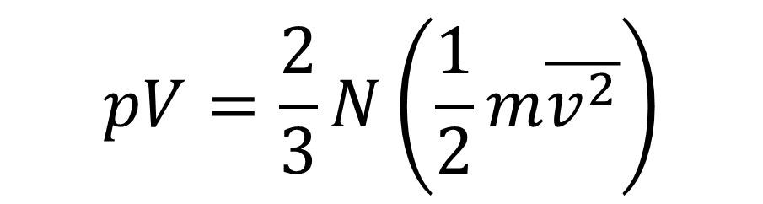
The kinetic molecular model of the ideal gas
Summary:
$$pV=\frac{2}{3}N\left(\frac{1}{2}m\overline{v^{2}}\right)$$
$\overline{E_{K}}=\frac{1}{2}m\overline{v^{2}}$ is the average translational kinetic energy of the molecules
$N\left(\frac{1}{2}m\overline{v^{2}}\right)$ is the total translational kinetic energy of the molecules

Slide 33


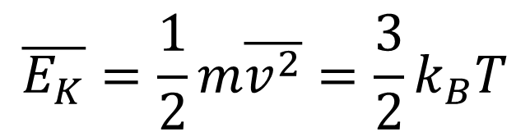
The kinetic molecular model of the ideal gas
Relation with the ideal gas law
$$pV=\frac{2}{3}N\left(\frac{1}{2}m\overline{v^{2}}\right)$$
$$pV=Nk_{B}T$$
Alternative form of the ideal gas law (see lesson 1)
The average kinetic energy of the molecules of the ideal gas is:
$$\overline{E_{K}}=\frac{1}{2}m\overline{v^{2}}=\frac{3}{2}k_{B}T$$
You just have to remember only this final result.
All intermediate steps of the demonstration are given for your information (you don’t have to remember them, but it is better if you understood them)

Slide 34
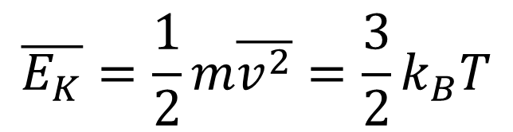
The kinetic molecular model of the ideal gas
$$\overline{E_{K}}=\frac{1}{2}m\overline{v^{2}}=\frac{3}{2}k_{B}T$$
This equation is the mathematical form of the statement you already know:
“the temperature of a gas is the macroscopic description of the velocity of the molecules of the gas.”
According to this equation, it should be more correct to say, “the temperature is the description of the average kinetic energy of the molecules of the gas” (assuming all the molecules have the same mass).

Slide 35
End of the lesson 1

Slide 36
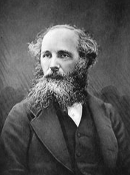
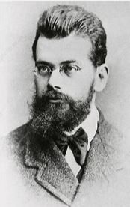
Lesson 2: the Maxwell-Boltzmann distribution
Teacher: Paul Briard
James Clerk Maxwell (1831-1879)
Ludwig Boltzmann (1844-1906)

Slide 37
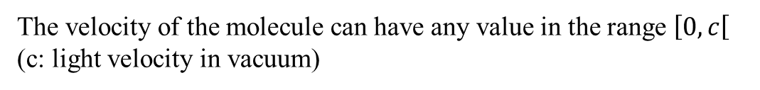
Introduction
As said in previous lesson, the molecules of a gas don’t have the same velocity.
The purpose of the present lesson is the description of the velocity of the molecules of the gas.
Very large number of molecules
The velocity is governed by statistical law
The velocity of the molecule can have any value in the range $\left[0,c\right[$ (c: light velocity in vacuum)

Slide 38
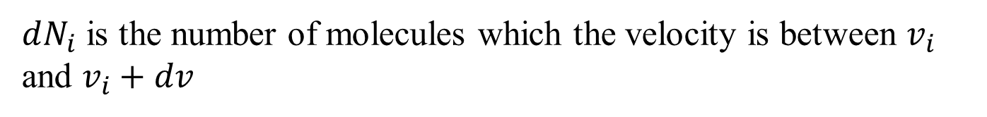
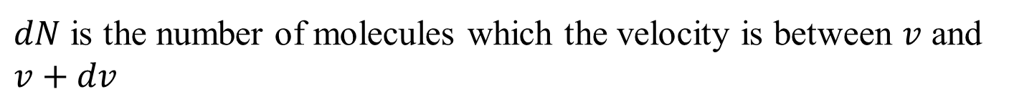



Introduction to a distribution function
The total number of molecules of the gas is N
dN
$$v$$
$$v$$
$$v+dv$$
$dN$ is the number of molecules which the velocity is between $v$ and $v+dv$
We can divide the possible velocities (discretization) in different ranges: $v_{i}$ such as $i=1, 2, …$
$dN_{i}$ is the number of molecules which the velocity is between $v_{i}$ and $v_{i}+dv$
Speed range
 | v₁ ～ v₂ | v₂ ～ v₃ | … | v_{i} ～ v_{i} +dv | …
 | dN₁ | dN₂ | … | dN_{i} | …
Number of molecules
In the range of speed

Slide 39
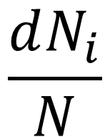
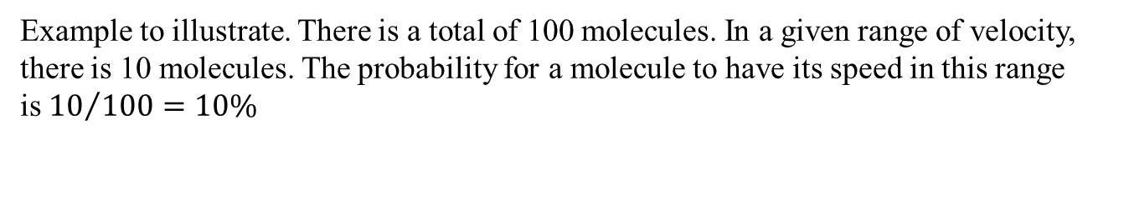
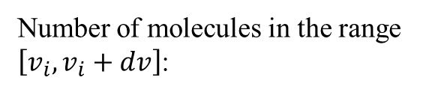
Introduction to a distribution function
The fraction of molecules which the velocity is in the range $\left[v_{i}, v_{i}+dv\right]$ is also
the probability for a molecule to have a velocity in a range $\left[v_{i}, v_{i}+dv\right]$:
$$\frac{dN_{i}}{N}$$
Number of molecules in the range $\left[v_{i}, v_{i}+dv\right]$:
Total number of molecules
 | v₁ ～ v₂ | v₂ ～ v₃ | … | v_{i} ～ v_{i} +dv | …
 | dN₁ | dN₂ | … | dN_{i} | …
 | dN₁/N | dN₂/N | … | dN_{i}/N | …
Speed range
Number of molecules
In the range of speed
Probability for a molecule to have its speed in the range
Example to illustrate. There is a total of 100 molecules. In a given range of velocity, there is 10 molecules. The probability for a molecule to have its speed in this range is${ 10}/{100}=10\%$

Slide 40
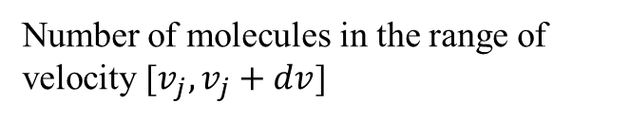
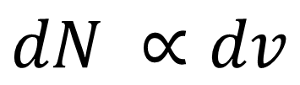
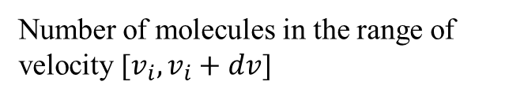
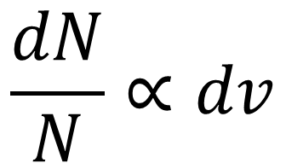
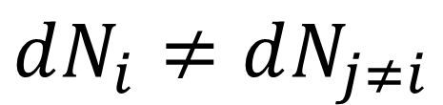

Introduction to a distribution function
The widest is the range of velocity, the biggest is the probability for a molecule to have its speed in this range.
$$\frac{dN}{N}∝dv$$
$$dN ∝dv$$
“$∝$” means “proportional to”
$dN$ depends to which interval of speed is considered:
$$dN_{i}≠dN_{j≠i}$$
Number of molecules in the range of velocity [$v_{i},v_{i}+dv$]
Number of molecules in the range of velocity [$v_{j},v_{j}+dv$]

Slide 41
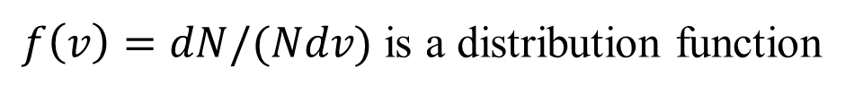
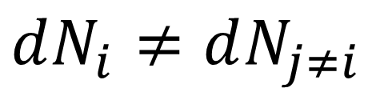
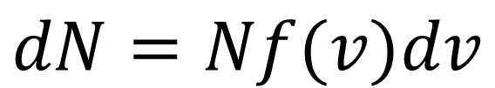
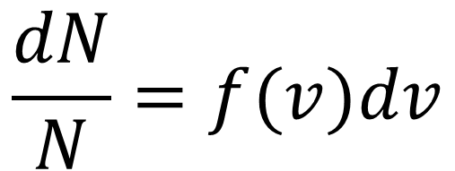
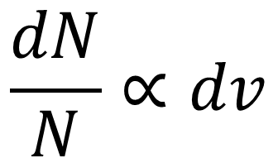
Introduction to a distribution function
$dN$ depends to which interval of speed is considered:
$$dN_{i}≠dN_{j≠i}$$
$$\frac{dN}{N}∝dv$$
$$\frac{dN}{N}=f(v)dv$$
The number of molecules which the velocity is in the range $\left[v,v+dv\right]$ is
$$dN=Nf(v)dv$$
$f\left(v\right)=dN/(Ndv)$ is a distribution function

Slide 42
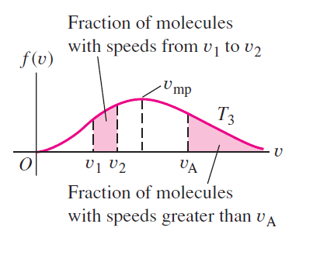


The Maxwell-Boltzmann distribution law
$$f\left(v\right)=4π{\left(\frac{m}{2πk_{B}T}\right)}^{3/2}v^{2}e^{−mv^{2}/2k_{B}T}$$
Because of this term, $f(v)$ is not a Gaussian function
m: the mass of individual molecules in the gas (we still consider all the molecules are identical)
$k_{B}$: Boltzmann constant
T: temperature
In a graph, the distribution is not so complicated:
Well, it’s a bit complicated, you don’t have to remember this equation

Slide 43
End of lecture 1, description of Maxwell-Boltzmann distribution continue next time.

